Slide 1
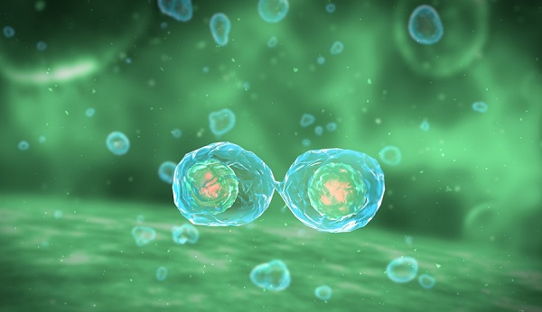
Cell Division: Mitosis & Meiosis
Chapters 11 & 12

Slide 2
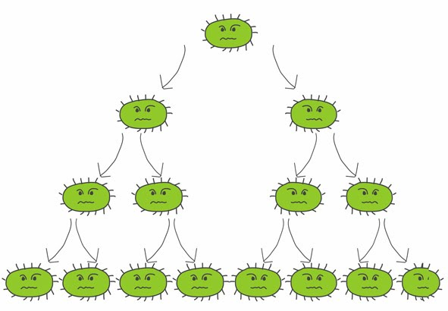
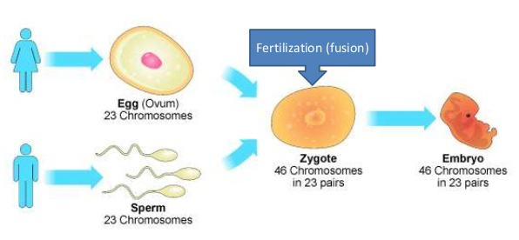
Cellular Reproduction (division) consists of making copies of all internal components of the cell, positioning those components, and then dividing the cell so that the new cells receive a copy of each of the important internal components.
*Cell division is the process by which cells reproduce themselves. Cell reproduction is highly complex.
Asexual Reproduction
vs.
Sexual Reproduction
Growth & replacement cells
1 parent
Offspring are genetically identical to the parent cell
Mixing of genes from parents
2 parents
Offspring have a unique combination of genes inherited from both parents
MITOSIS
Meiosis

Slide 3

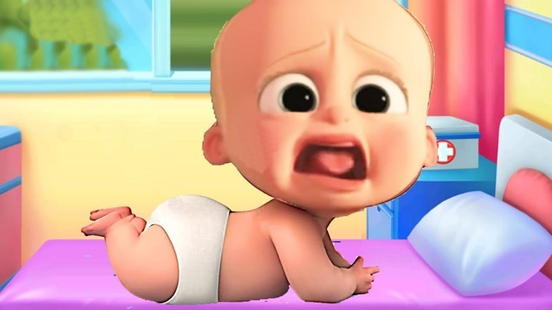
MEMORY MAKER!
Mitosis
makes my “toes”
Meiosis
makes “me”

Slide 4
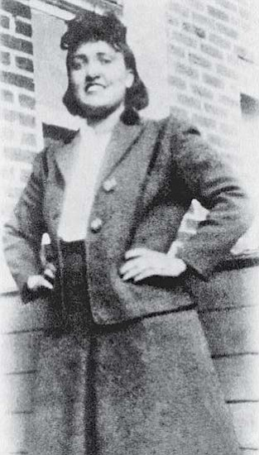
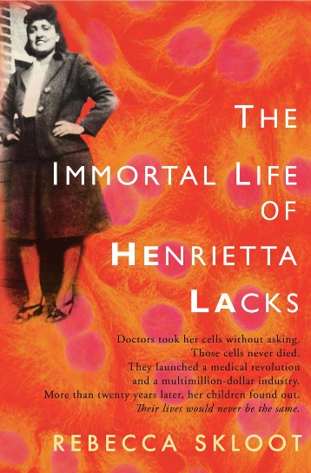
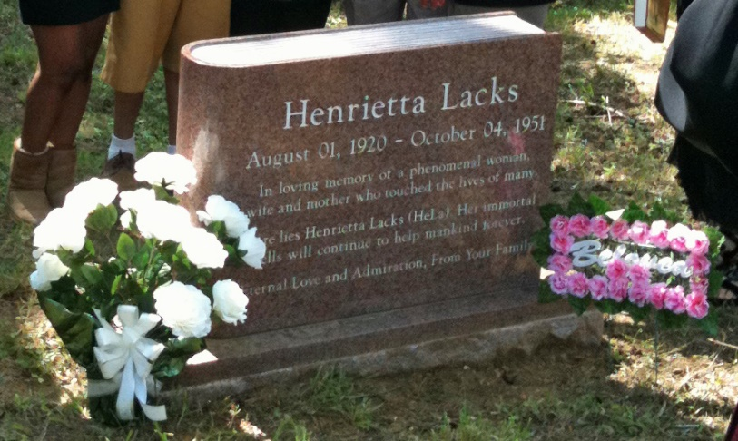
HeLa Cells
“The Mother of Medicine”
What are HeLa Cells and why are they so important?
The HeLa cells survived, thrived, and multiplied outside her body, so much so that they have been in continual use in labs around the world for 65 years, even though Lacks herself succumbed to cancer in 1951.
Knowing and understanding cell division answered the following questions…
What kind of information guides inheritance?
How is information copied and distributed to daughter cells?
What kinds of mechanisms actually parcel out the information to the daughter cells?

Slide 5
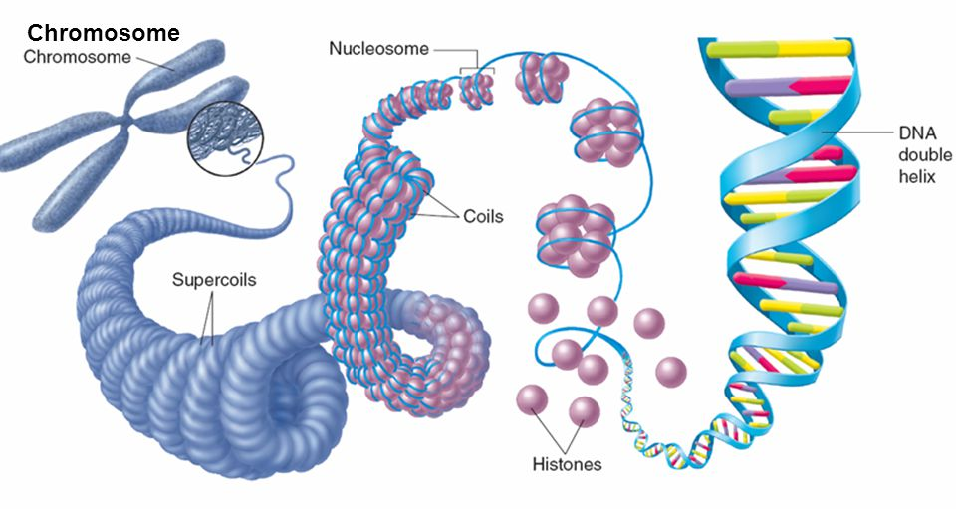
Chromosome Structure:
DNA itself is wound up into a thin fiber which is wrapped around proteins called “Histones.”
The Histone & DNA structure forms a beadlike structure known as a “Nucleosome.”
Nucleosomes coil together forming “Chromatin.”
Chromatin loops and coils together forming supercoils. Supercoils bunch together forming “Chromosomes.”

Slide 6
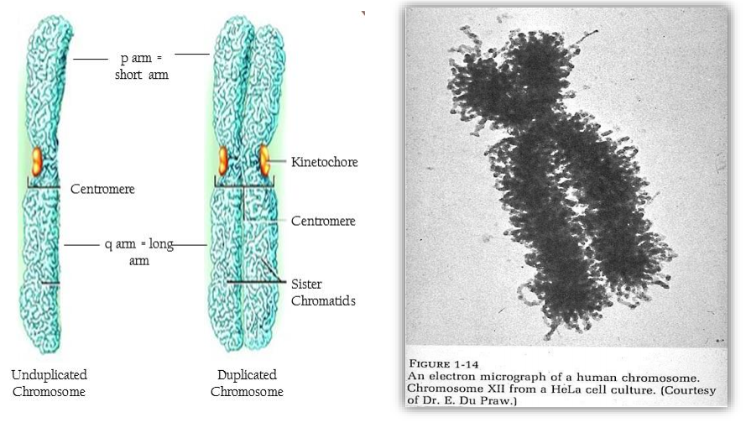
Chromosome Structure:
Telomeres
Before DNA replication, a chromosome consists of one continuous double-stranded DNA molecule (unduplicated). After replication, each chromosome consists of two double-stranded DNA molecules (duplicated) attached at a single point – centromere. Each of the double-stranded DNA molecules is an exact copy of the other. Each of the copies is called a chromatid.

Slide 7
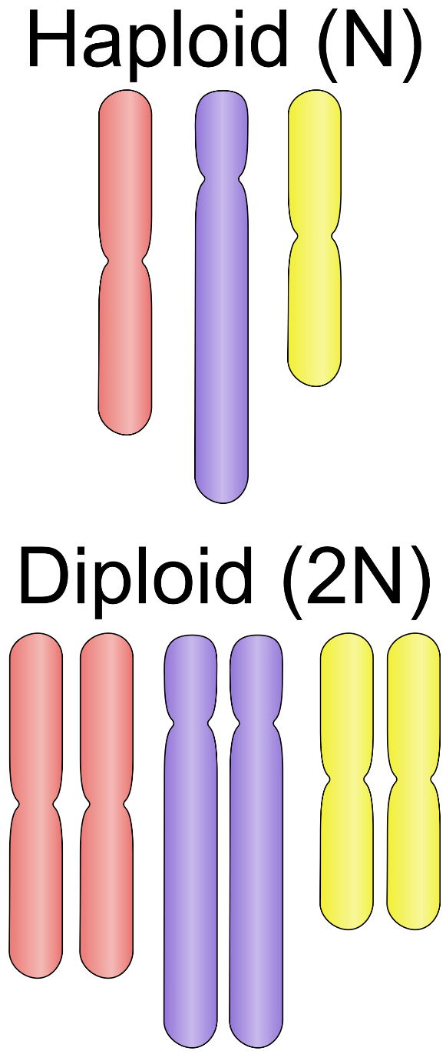
Haploid vs. Diploid
cells with only one set of chromosomes (one gene for each trait)
all gametes (sex cells)
haploid cells are result of meiosis
cells having homologous chromosomes (two genes for each trait)
all somatic cells (body cells)
diploid cells are created through mitosis

Slide 8
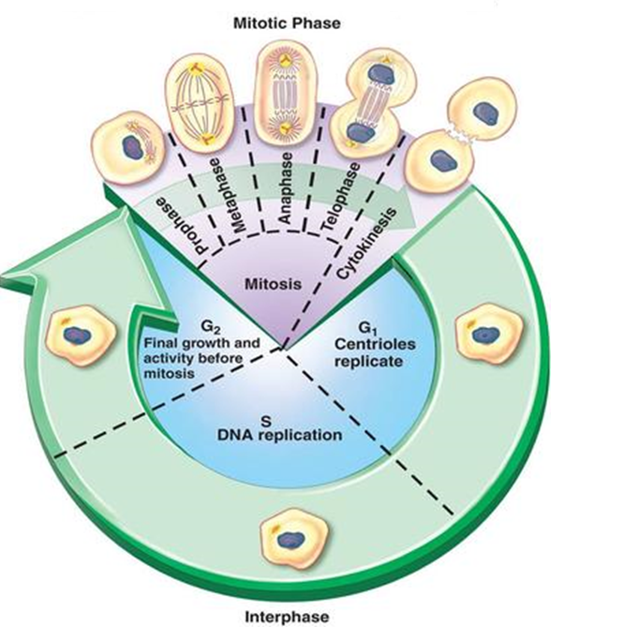
Eukaryotic Cell Cycle:
(nuclear division)
Interphase:
Mitosis:
Cytokinesis -
G1 – growth phase prior to DNA replication
S – DNA replication occurs
G2 – final growth phase when the cell “double checks”
(cytoplasmic division)
Prophase
Metaphase
Anaphase
Telophase
cytoplasmic division occurs
(growth)

Slide 9
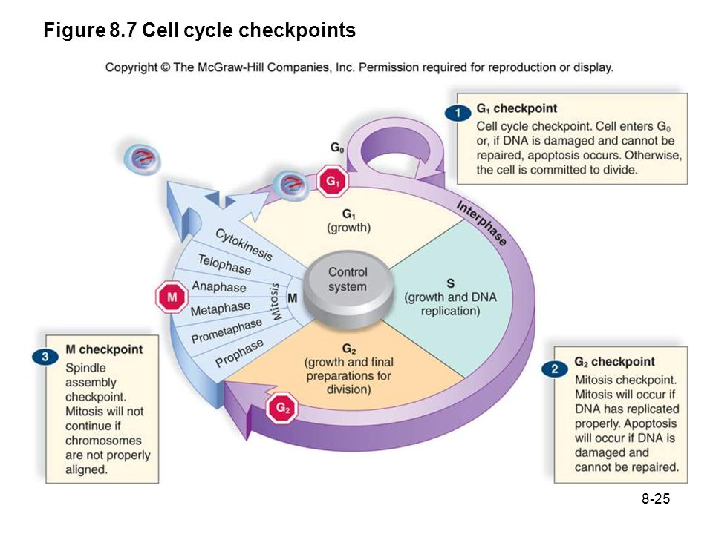

Slide 10
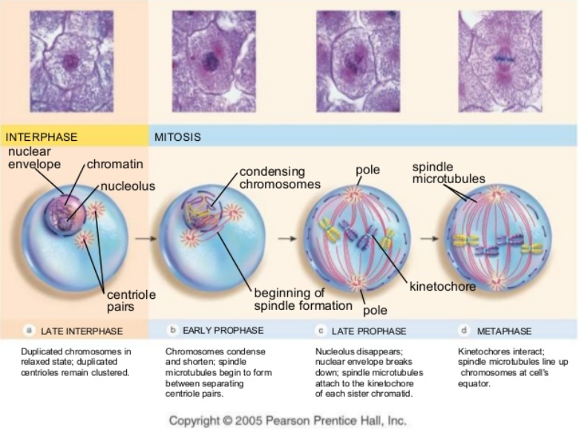

Slide 11
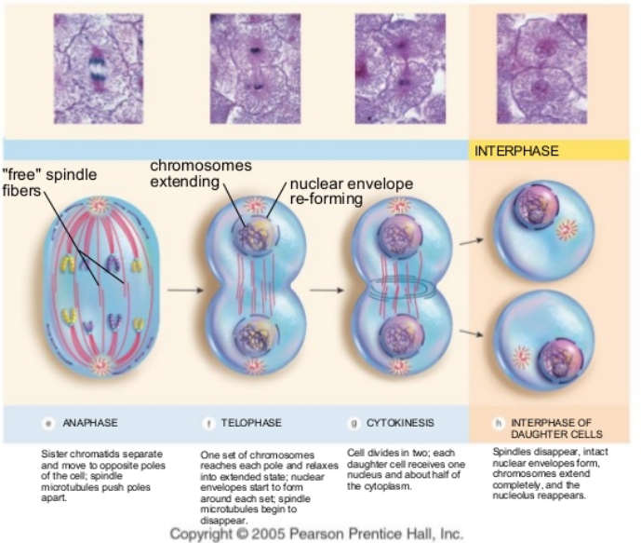

Slide 12
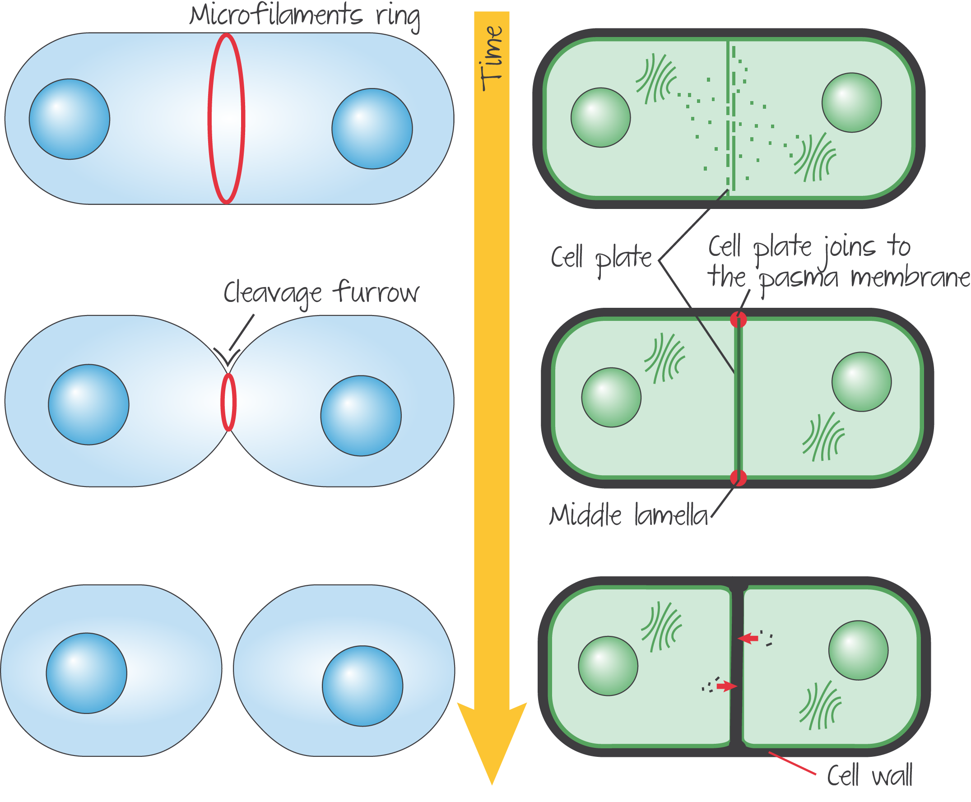
Animal Cell Cleavage vs. Plant Cell Cytokinesis

Slide 13
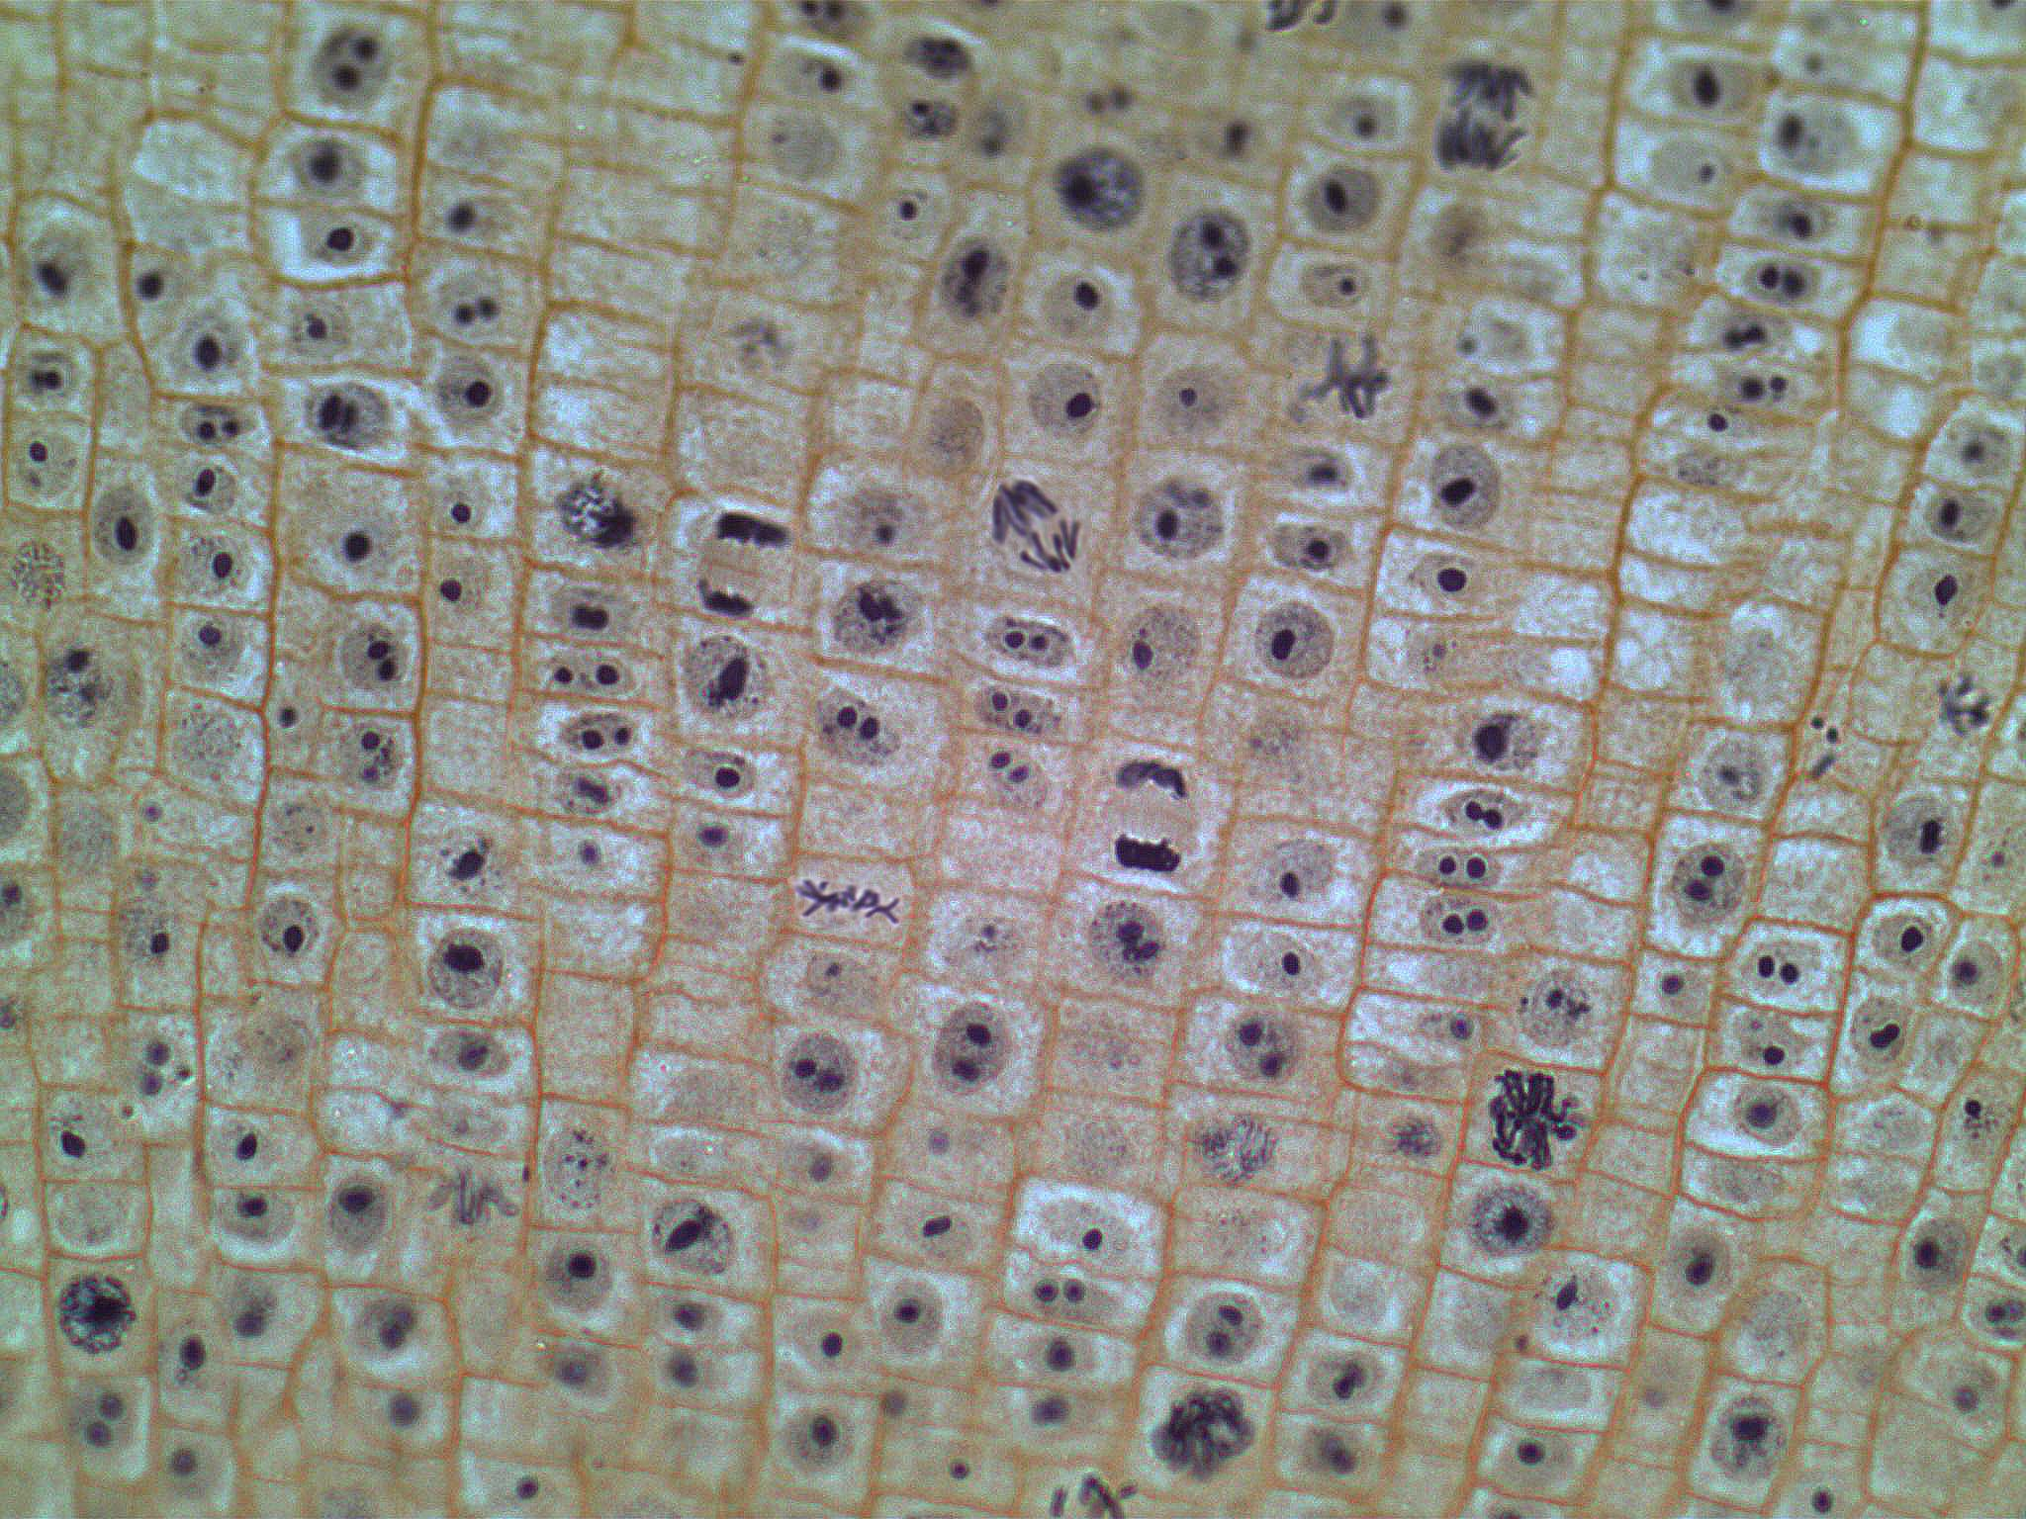

Slide 14
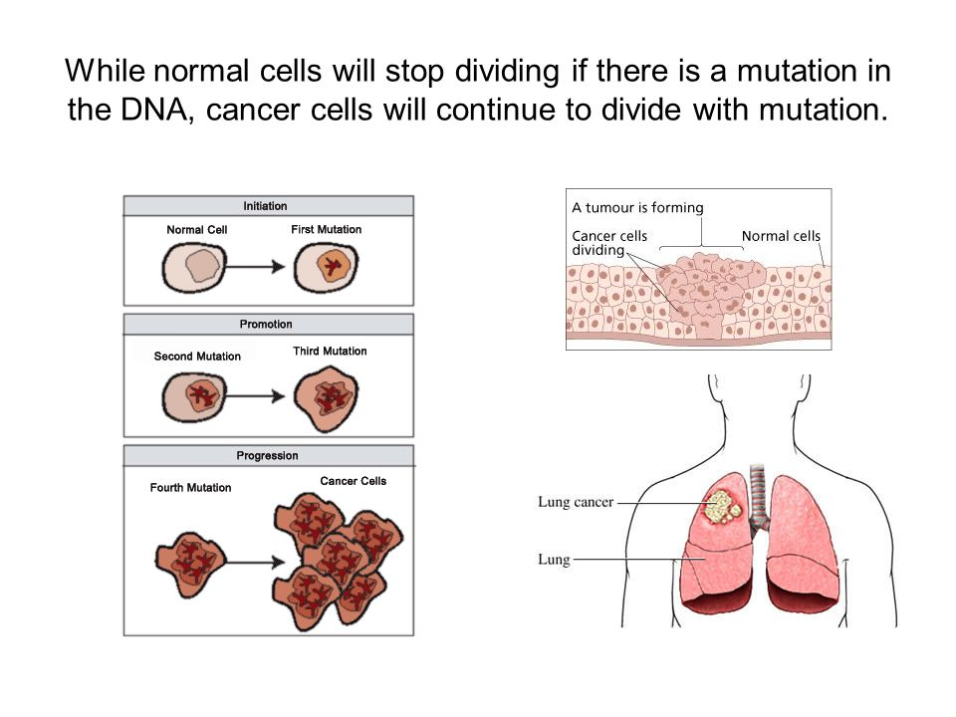
What happens when mitosis looses control?

Slide 15


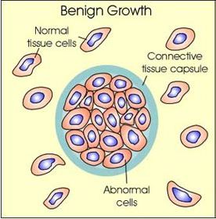
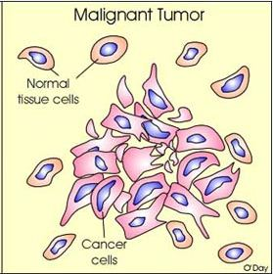
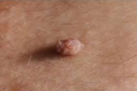
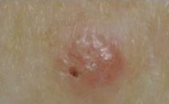
Types of tumors:
Benign Tumor
Malignant Tumor
Slow growing
Capsulated
Non-invasive
Do not metastasize
Well differentiated
Suffix “-oma” (ex: fibroma)
Fast growing
Non-capsulated
Invasive & infiltrate
Metastasize
Poorly differentiated
Suffix “-carcinoma” or “- sarcoma”

Slide 16
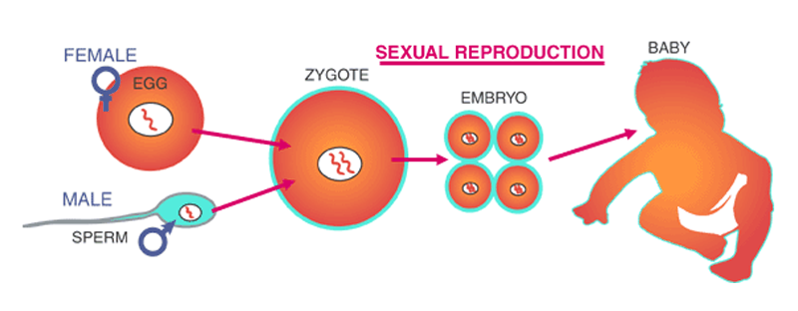
Sex – the combination of genetic information from two different sources.
In most eukaryotes, sex involves the fusion of two cells, egg and sperm. Their fusion is called syngamy. Egg cells and sperm cells are gametes. Their production is called gametogenesis, more specifically oogenesis when referring to egg cell production and spermatogenesis when referring to sperm cell production.
Haploid (n)
Haploid (n)
Diploid (2n)
Most eukaryotes are diploid (2N) and their gametes are haploid (N).
Gametogenesis makes haploid cells from diploid cells:
2N → N
Syngamy combines two haploid cells to produce a diploid cell:
N + N → 2N

Slide 17

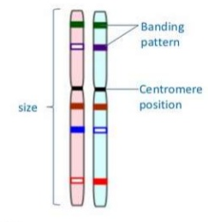
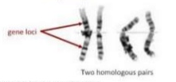
Homologous chromosomes carry the same sequence of genes but not necessarily the same alleles of those genes
Homologous Chromosomes
same
structure
Somatic cell nuclei (body cells) are diploid (2n).
They contain an homologous pair of each chromosome.
One of the pair is paternal – inherited from the father.
The other is maternal – inherited from the mother.
Homologous chromosomes are the same size and structure. They carry the same genes at the same loci.
Alleles carried at each locus may vary.
22 of the human chromosome pairs are homologous. The other pair, the sex chromosomes, are non-homologous.

Slide 18
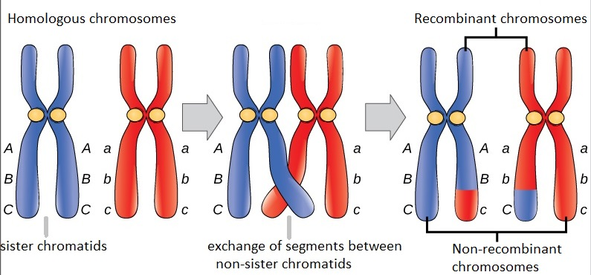
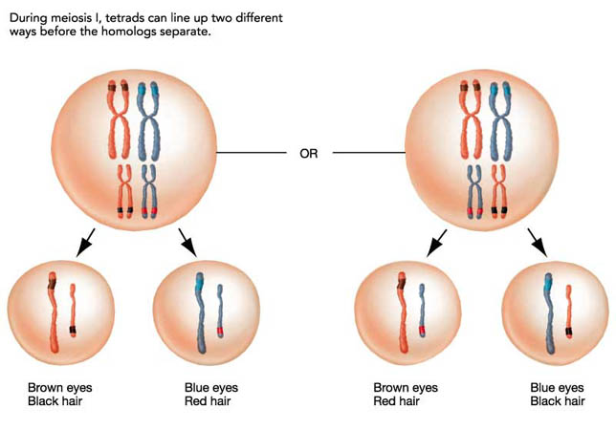
Crossing over and random orientation promotes genetic variation
Offspring of sexual reproduction are always an unpredictable blend of the characteristics of the two parents – much of this randomness is due to Meiosis
Each gamete produced by a parent has a different combination of alleles due to two major features of Meiosis:
Crossing over: Swapping of alleles between homologous chromosomes means infinite new combinations of alleles can be created and passed down to offspring
Random Orientation of Bivalents: Which one chromosome of each homologous pair that a gamete receives is based on their orientation in Metaphase I.

Slide 19
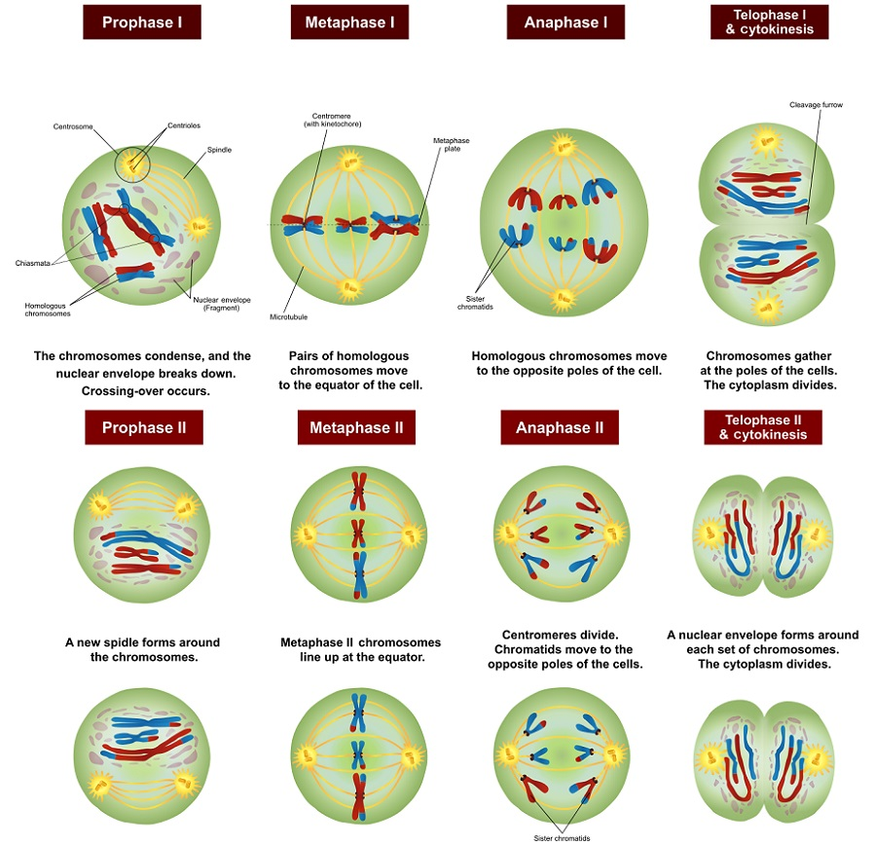
Meiosis

Slide 20
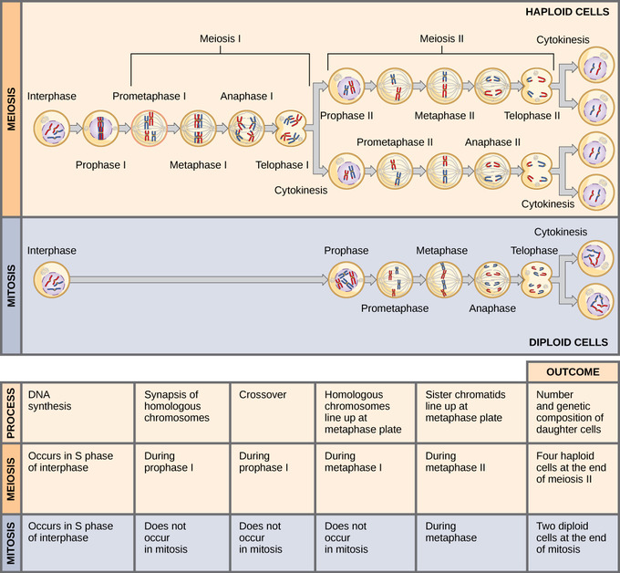
Review: Mitosis vs Meiosis

Slide 21
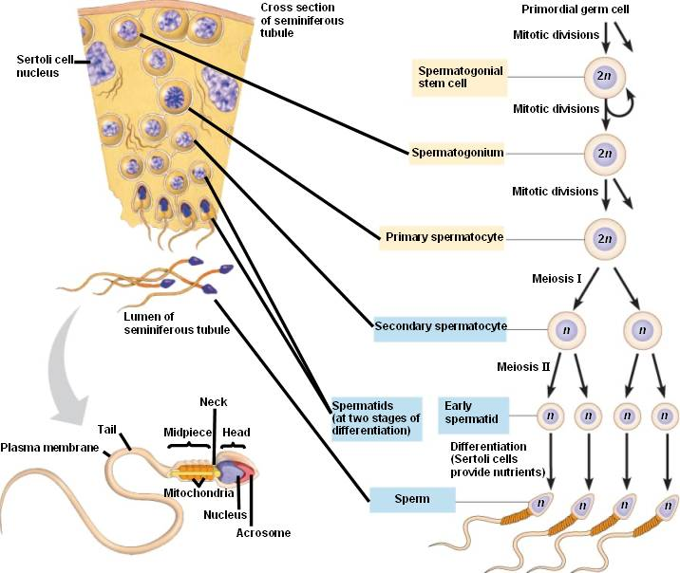
Spermatogenesis
Takes place inside the seminiferous tubules of the testes, called spermatogenesis.
• Primitive germ cells are called spermatogonia, these are present in the testes during embryonic development and childhood.
• Prior to puberty spermatogonia divide by mitosis to produce more.
• Mature sperm production begins at puberty and does not end.
• The process of spermatogenesis takes 70-80 days.
• All stages of sperm development are present in the tubules at any given time.
Controlled by FSH & Testosterone
↑ spermatogonia proliferation
↑ Sertoli androgen binding protein

Slide 22
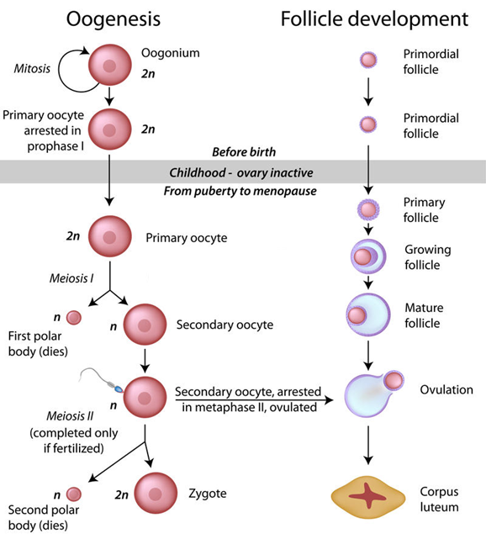
Oogenesis
Oogenesis occurs on the surface of the ovary.
• Primary oocytes are inactive until puberty.
• Follicle stimulating hormone (FSH) causes some primary follicles to mature - meiosis starts inside maturing follicle
*produces a 2° oocyte and the
first polar body - meiosis is
completed after ovulation only if
sperm penetrates
*two additional polar bodies are
produced
All primary follicles that a female will ever produce are formed in the ovaries during the first six months of embryonic life and most will disappear.
7 million – six months fetal development
2 million at birth
400,000 at puberty

Slide 23
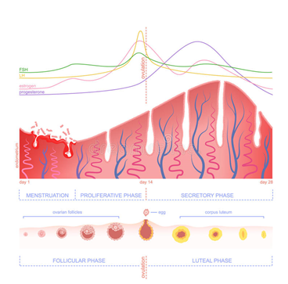
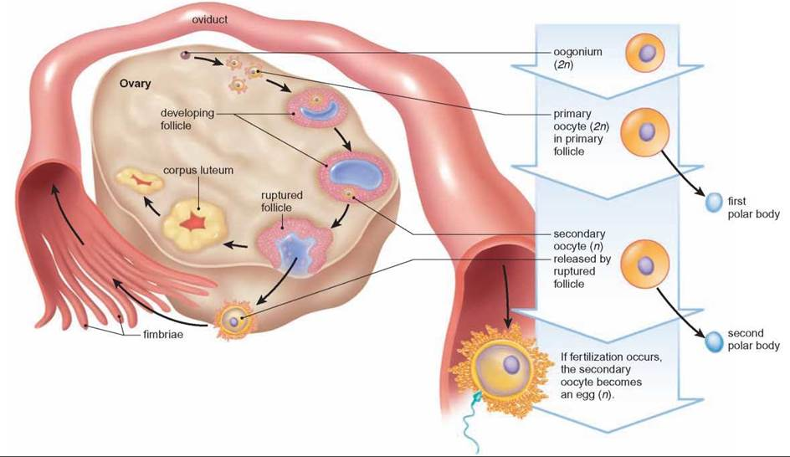
Menstrual cycle… it’s complicated!
The menstrual cycle is the reproductive cycle in women, which starts with a period (menstruation), if the woman is not pregnant.
There are four hormones involved: follicle stimulating hormone (FSH), luteinizing hormone (LH), estrogen, & progesterone.
FSH (released by the pituitary gland) causes eggs to mature in the ovaries.
FSH stimulates ovaries to produce estrogen.
Estrogen inhibits further release of FSH and stimulates release of LH.
LH (released by the pituitary gland) stimulates the release of an egg (ovulation) from an ovary.
LH stimulates secretion of progesterone by the empty follicle.
Progesterone inhibits the release of LH and FSH.
Estrogen and progesterone maintain the lining of the uterus.

Slide 24
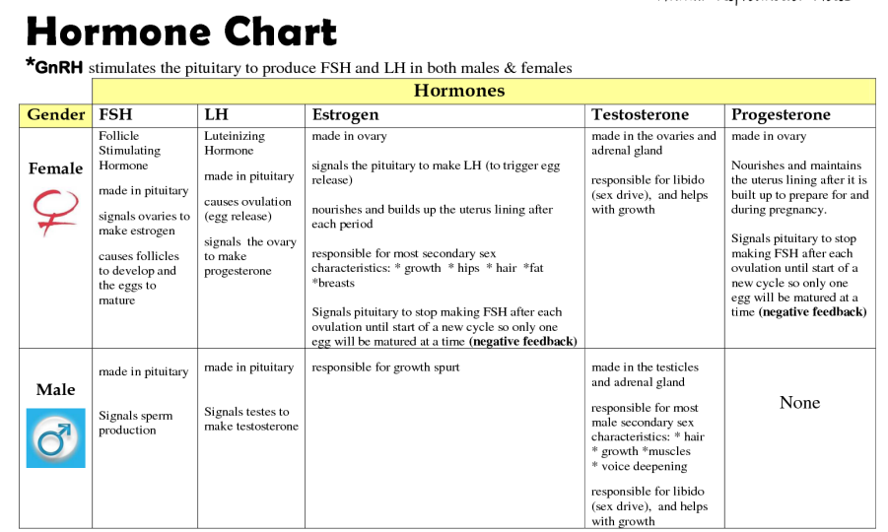

Slide 25
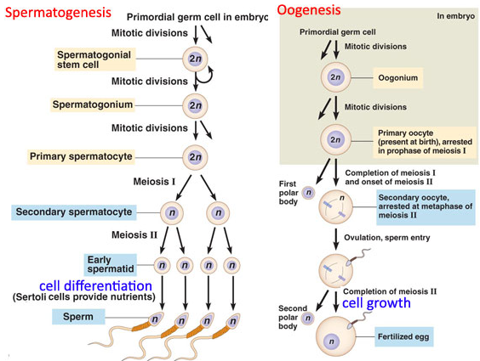

Slide 26
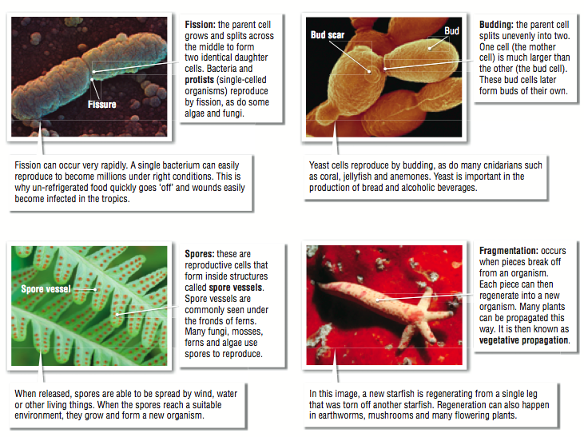
Types of Asexual Reproduction:

Slide 27
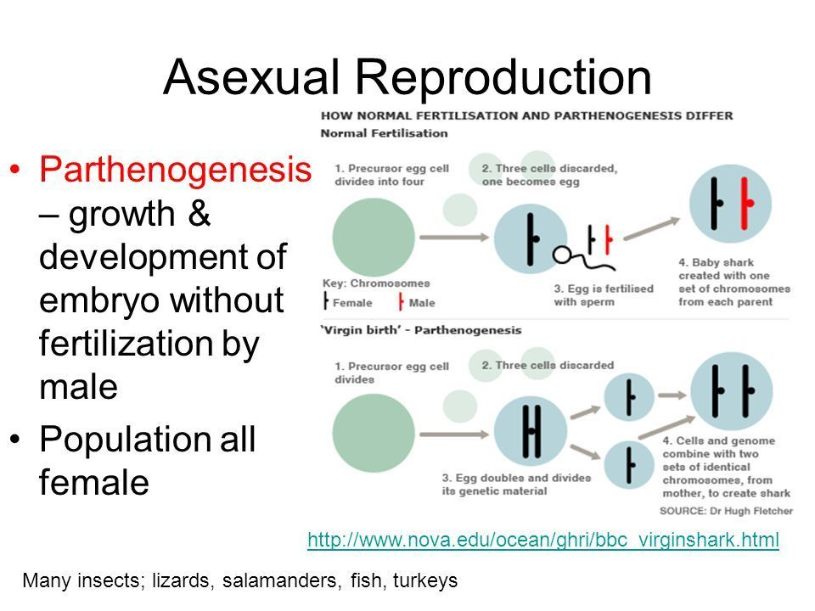

Slide 28
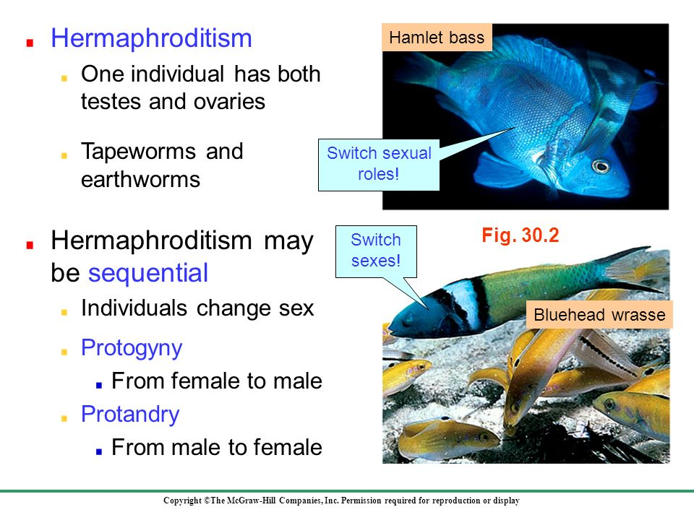
Types of Sexual Reproduction:

Slide 29
